Slide 1
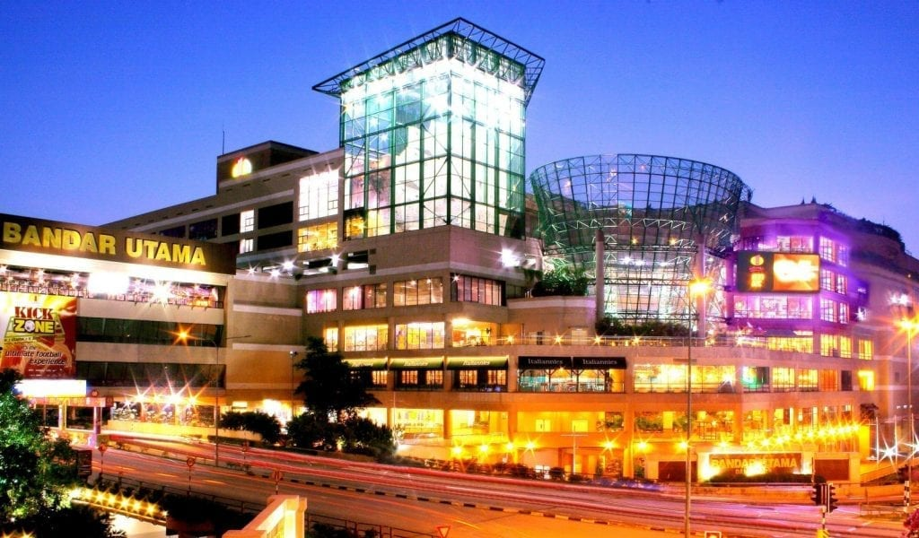
OPENING A NEW SHOPPING MALL, IN KAULA LAMPUR,MALYASIA

Slide 2
BUSINESS PROBLEM
The objective of this capstone project is to analyse and select the best locations in the city of Kuala Lumpur, Malaysia to open a new shopping mall.
Using data science methodology and machine learning techniques like clustering, this project aims to provide solutions to answer the business question: In the city of Kuala Lumpur, Malaysia, if a property developer is looking to open a new shopping mall, where would you recommend that they open it?

Slide 3
DATA
List of neighbourhoods in Kuala Lumpur. This defines the scope of this project which is confined to the city of Kuala Lumpur, the capital city of the country of Malaysia in South East Asia.
Latitude and longitude coordinates of those neighbourhoods. This is required in order to plot the map and also to get the venue data.
Venue data, particularly data related to shopping malls. We will use this data to perform clustering on the neighbourhoods.
Sources of data and methods to extract them
Wikipedia page (https://en.wikipedia.org/wiki/Category:Suburbs_in_Kuala_Lumpur)
Foursquare API for Venue data.

Slide 4
METHODOLOGY
Web scraping wikepedia page for neighbourhoods list.
Get latitude and longitude coordinates using Geocoder.
Use Foursquare API to get venue data.
Group data b neighbourhood and taking the mean of the frequency of occurrence of each category.
Filter venue category by shopping mall.
Perform clustering on the data by using the K means clustering.
Visualize the clusters in the maps using folium.

Slide 5
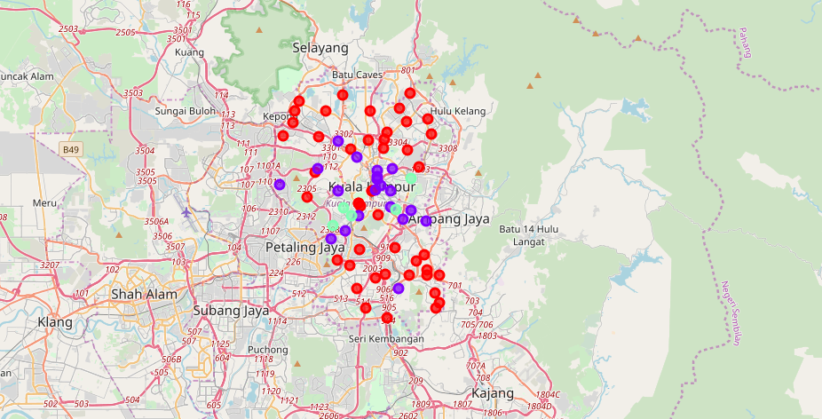
RESULTS
The results from the k-means clustering show that we can categorize the neighbourhoods into 3 clusters based on the frequency of occurrence for “Shopping Mall”:
Cluster 0: Neighbourhoods with moderate number of shopping malls
Cluster 1: Neighbourhoods with low number to no existence of shopping malls
Cluster 2: Neighbourhoods with high concentration of shopping malls

Slide 6
Conclusion
The neighbourhoods in cluster 1 are the most preferred locations to open a new shopping mall.
The findings of this project will help the relevant stakeholders to capitalize on the opportunities on high potential locations while avoiding overcrowded areas in their decisions to open a new shopping mall.

